Slide 1
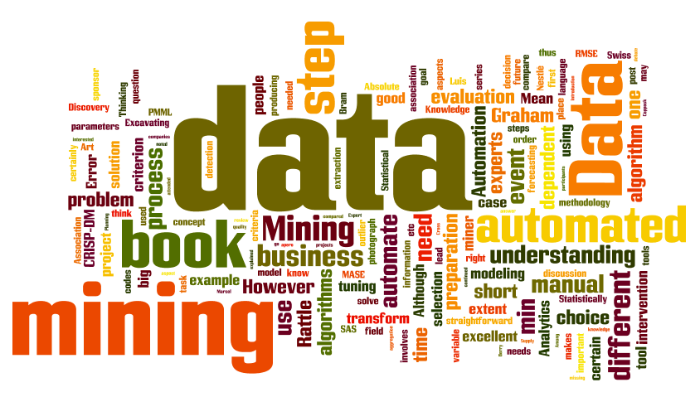
IT-533: Data Mining
Week 4
Sonja Streuber

Slide 2
Agenda
# | Topic | Reading | Due 11:59 pm CST on Blackboard
3 | More Statistics: Correlation, Regression and Chi Square, ANOVA | Zhao 5 Zacharski 2 Han/ Kamber 2 Ledolter 3 (Standard Linear Regression) YouTube videos as posted Lynda Course “Up and Running with Python” Install Python 3.5.2 | MW Quiz 4: Adv. Stats in R S: FINAL_PROJECT_4: Using R or Excel, determine which attributes in your dataset are closely correlated. Select two attributes for which to predict future values with regression. Use Excel and R. How do the results differ, and why?

Slide 3
Chi square and correlation

Slide 4
How is Data Related?
Correlation
Correlation measures the strength of relationship between two variables X and Y.
Chi Square
Most often measured with Pearson’s correlation coefficient r for linear correlation
On a scatter graph, people draw a line of best fit (= regression line) to show the direction of the correlation
Linear correlation is between +1 and −1 inclusive, where 1 is total positive correlation, 0 is no correlation, and −1 is total negative correlation
Tests how likely it is that an observed distribution is due to chance.
Requires a two-way table
Point of the test is to prove or disprove a null hypothesis; if null hypothesis is disproven, alternative hypothesis is correct.
Also called a "goodness of fit" statistic because it measures how well the observed distribution of data fits with the distribution that is expected if the variables are independent.
Notes:
http://neoacademic.com/2009/09/10/a-plain-english-explanation-of-correlation/

Slide 5
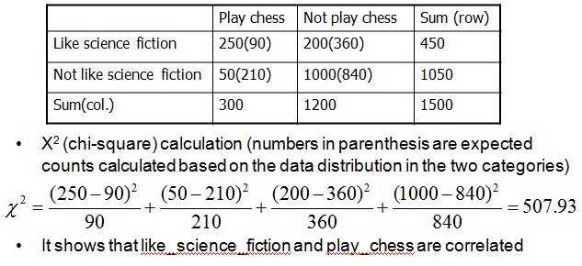


Chi Square (Nominal Data)
Χ² (chi-square) test
The larger the Χ² value, the more likely the variables are related
The cells that contribute the most to the Χ² value are those whose actual count is very different from the expected count
Example:
Now what?
Notes:
The greater the calculated chi-square value, the more likely the sample does not conform to the expected frequencies, and therefore you would reject the null hypothesis

Slide 6
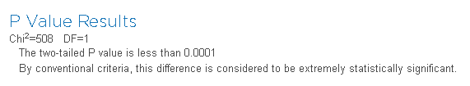
The Real Use of Chi Square
The real use of Chi Square is within the Hypothesis testing framework.
H₀: People who like science fiction do not play chess.
H_{a}: People who like science fiction do play chess.
We need:
Output of Chi Square calculation
Degrees of Freedom: How many numbers in the grid are actually independent (i.e. the number of cells you need to fill in before, given the totals in the margins, you can fill in the rest of the grid using a formula). In our example, the number of rows minus one times the number of columns minus one: (R-1)*(C-1). In our simple 2x2 grid, the degrees of independence are therefore (2-1)*(2-1), or 1!
We then calculate the probability, or p-value, of independence, which must be over 5% to validate H₀, using a commonly available calculator:
There is a 0.001% probability that any deviation from expected results is due to chance. So, H₀ is rejected!
Notes:
For p > 0.5 with 1 df, Chi square must be < 4.

Slide 7
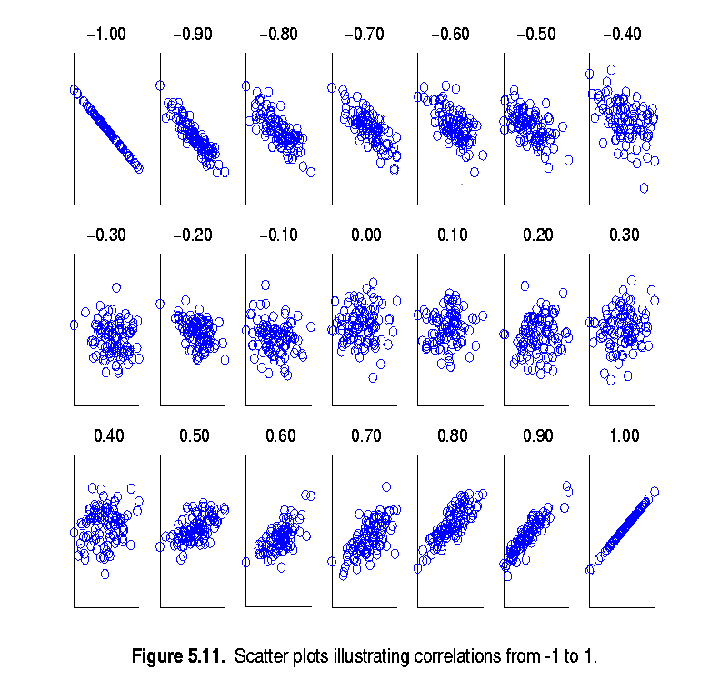
Correlation Analysis (Numerical Data)
Correlation coefficient (also called Pearson’s coefficient)
where n is the number of tuples, and are the respective means of A and B, σ_{A} and σ_{B} are the respective standard deviation of A and B, and Σ(AB) is the sum of the AB cross-product.
If r_{A,B} > 0, A and B are positively correlated (A’s values increase as B’s).
r_{A,B} = 0: independent; r_{A,B} < 0: negatively correlated

Slide 8
Chi square and correlation in R

Slide 9
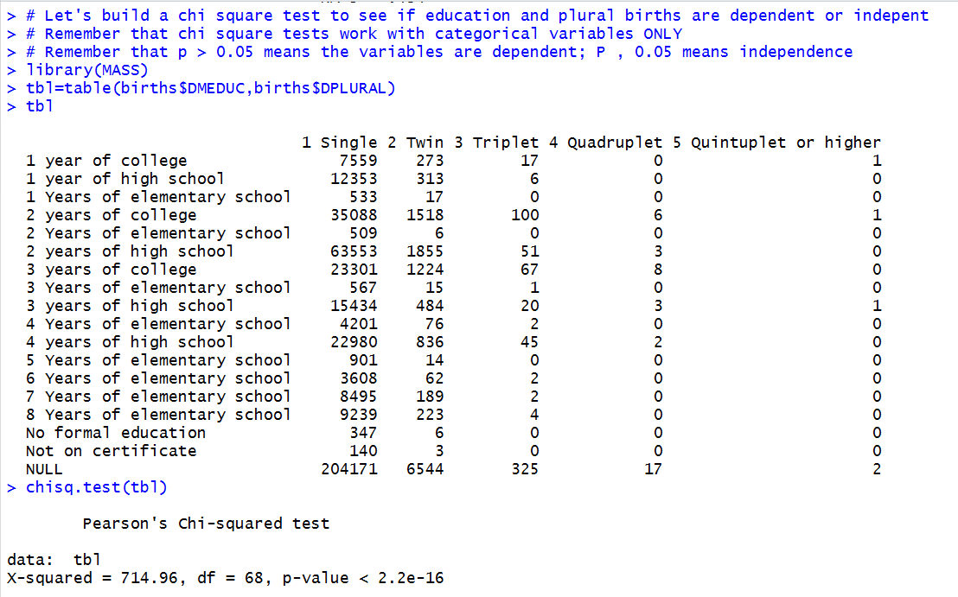
Chi Square
Chi Square on the table
Two-way table
Results: p-value is < 0.5

Slide 10
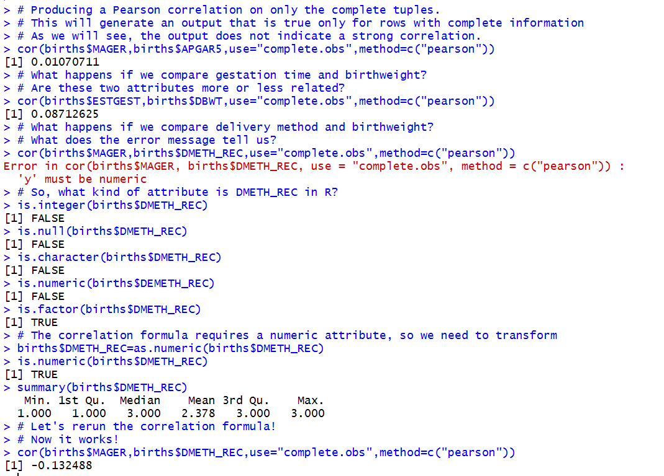
Correlation
Pearson Correlation Coefficient
Both variables must be numeric
Compare the output—which variables are most closely correlated?

Slide 11
regression

Slide 12
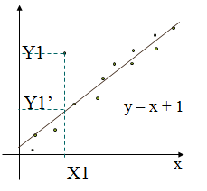
Regression Analysis
Regression analysis: Modeling and analysis of numerical data consisting of values of a dependent variable (also called response variable or measurement) and of one or more independent variables (aka. explanatory variables or predictors)
The parameters are estimated so as to give a "best fit" of the data
y
Used for prediction (including forecasting of time-series data), inference, hypothesis testing, and modeling of causal relationships
Linear Function y = c0 + c1x1 + c2x2 + · · · + ckxk, where x1, x2, · · · , xk are predictors and y is the response to predict

Slide 13
Regression Analysis and Log-Linear Models
Linear regression
Y = w X + b
Two regression coefficients, w and b, specify the line and are to be estimated by using the data at hand
Using the least squares criterion to the known values of Y1, Y2, …, X1, X2, ….
Multiple regression
Y = b0 + b1 X1 + b2 X2.
Many nonlinear functions can be transformed into the above
Log-linear models
Approximates discrete multidimensional probability distributions
Estimate the probability of each point (tuple) in a multi-dimensional space for a set of discretized attributes, based on a smaller subset of dimensional combinations
Useful for dimensionality reduction and data smoothing
Allows a response variable Y to be modeled as a linear function of multidimensional feature vector
Data are modeled to fit a straight line

Slide 14
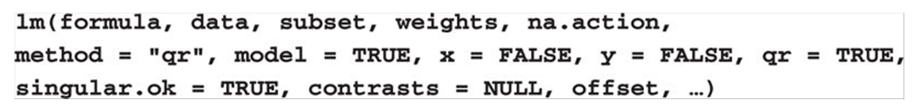
Regression
Most data mining applications deal with the prediction of the response. We hope that the regression relationship that we have established on a training set can help us with the prediction of new cases.
The key to establishing whether a regression model helps with prediction is to evaluate the predictions on a new test data set that has not been used for the estimation of the parameters.
The quality of the predictions is typically assessed through statistics such as the mean (forecast) error, the root mean square error, and the mean absolute percent error (Ledolter 42)
R Code

Slide 15
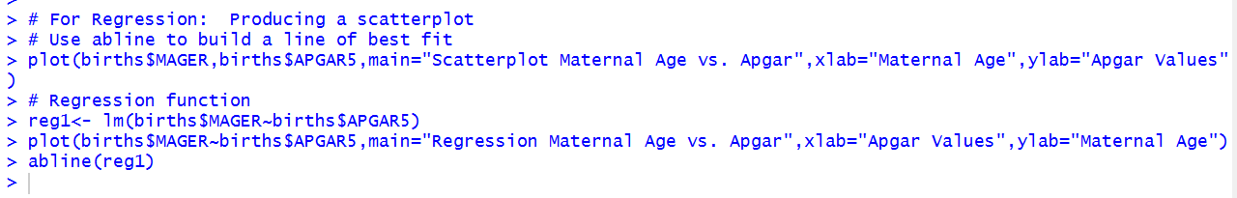
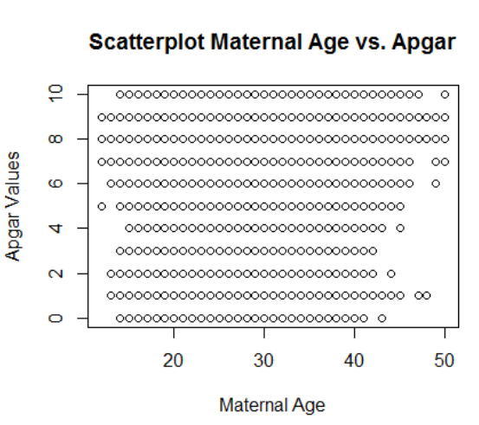
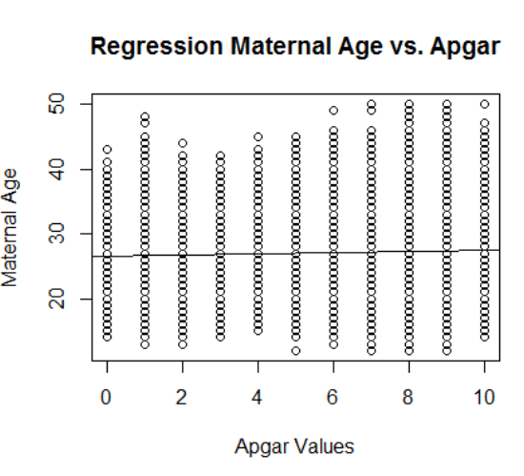
Regression in R—Births Dataset
What does the fit line tell us?

Slide 16
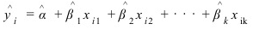
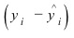
Multiple Regression--Input
Multiple regression is an extension of simple linear regression. It is used when we want to predict the value of a variable based on the value of two or more other variables. The variable we want to predict is called the dependent variable (or sometimes, the outcome, target or criterion variable).
The formula gets a bit more complicated because we have more than one x:
y = f (x₁,x₂,…, x_{k}) +ε = α +β₁x₁+β₂x₂ + ⋯ + β_{k}x_{k} +ε,
The error ε follows a normal distribution with mean zero and variance σ²
This expression is called the fitted value of the response y_{i}, . These are all the y values that sit on the line, i.e. that are part of this model:
and the difference between model and reality is called the residual.

Slide 17
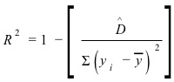
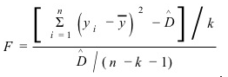
Multiple Regression--Output
The output of a Multiple Regression includes two important things:
The R² value: The proportion of variation that is explained by the regression model. If there is no relationship between the X and Y variables, then the ratio of the residual variability of the Y variable to the original variance is equal to 1.0. Then R-square would be 0. If X and Y are perfectly related then there is no residual variance and the ratio of variance would be 0.0, making R-square = 1
The F-statistic: A large value of the F-statistic leads us to reject the null hypothesis β₁ = β₂ = ⋯ = β_{k} = 0; the null hypothesis expresses that none of the predictor variables have an influence.
By adding variables to a model we are bound to decrease the error sum of squares ̂ above D (in the worst case, it can stay the same) and consequently increase the R-square.

Slide 18
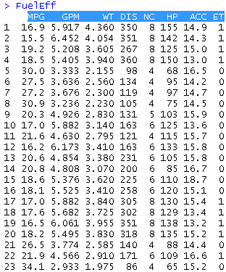
Full Regression Cycle
MPG GPM WT DIS NC HP ACC ET
Fuel Efficiency of Automobiles Dataset: http://www.biz.uiowa.edu/faculty/jledolter/datamining/datatext.html
Attributes:
MPG = Miles per gallon
GPM = Gallons per 100 miles
WT = Weight in 1,000 lb
DIS = Displacement in cubic inches
NC = Number of cylinders
HP = Horsepower
ACC = Acceleration in seconds
ET = Engine Type: V(0), straight (1)
Walk through R example file.

Slide 19
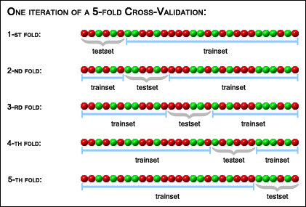
Cross Validation
Cross-validation removes one case from the data set of n cases, fits the model to the reduced data set, and predicts the response of that one case that has been removed from the estimation. This is repeated for each of the n cases. The summary statistics of the n genuine out-of-sample prediction errors (mean error, root mean square error, mean absolute percent error) help us assess the out-of-sample prediction performance.
Partition a sample of data into complementary subsets
Perform the analysis on one subset (called thetraining set)
Validate the analysis on the other subset (called the validation set or testing set).
Notes:
In cross-validation, you make a fixed number of folds (or partitions) of the data, run the analysis on each fold, and then average the overall error estimate.

Slide 20
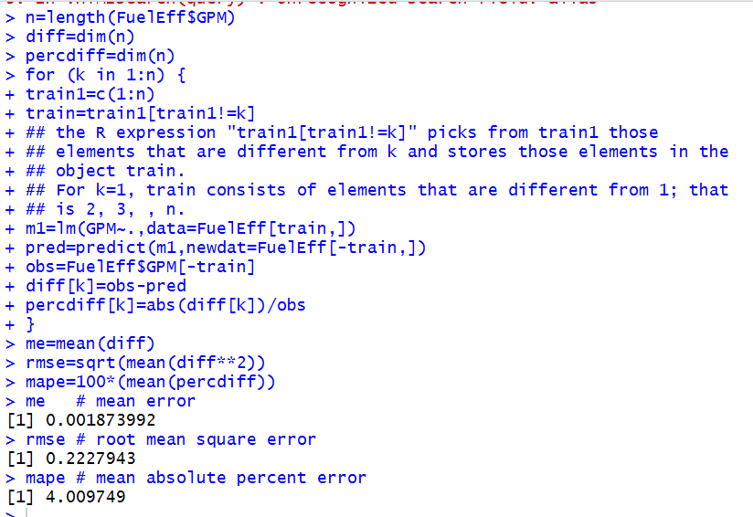
Cross Validation in R
Google the following:
Mean error
Root mean square error
Mean absolute percent error

Slide 21
anova

Slide 22
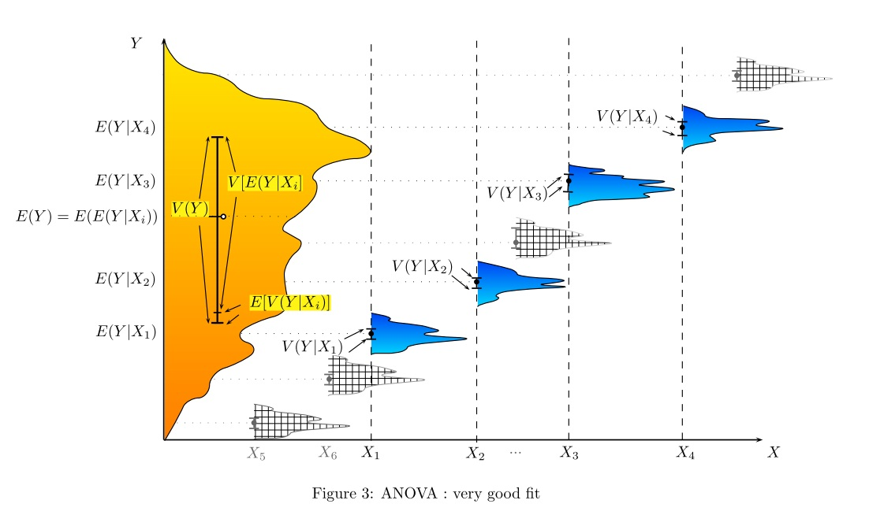
ANOVA
Analysis of variance (ANOVA) is a collection of statistical models used to analyze the differences among group means and their associated procedures (such as "variation" among and between groups)
In one-way ANOVA the data is sub-divided into groups based on a single classification factor → we need categorical data, i.e. Number of Cylinders, for this.

Slide 23
ANOVA
To determine whether any of the differences between the means are statistically significant, compare the p-value to your significance level (usually 0.05) to assess the null hypothesis. The null hypothesis states that the population means are all equal.
A test result (calculated from the null hypothesis and the sample) is statistically significant if it is deemed unlikely to have occurred by chance, assuming the truth of the null hypothesis. (p-value > 0.05)
A statistically significant result, when a probability p-value < 0.05 justifies the rejection of the null hypothesis, but only if the a priori probability of the null hypothesis is not high.

Slide 24
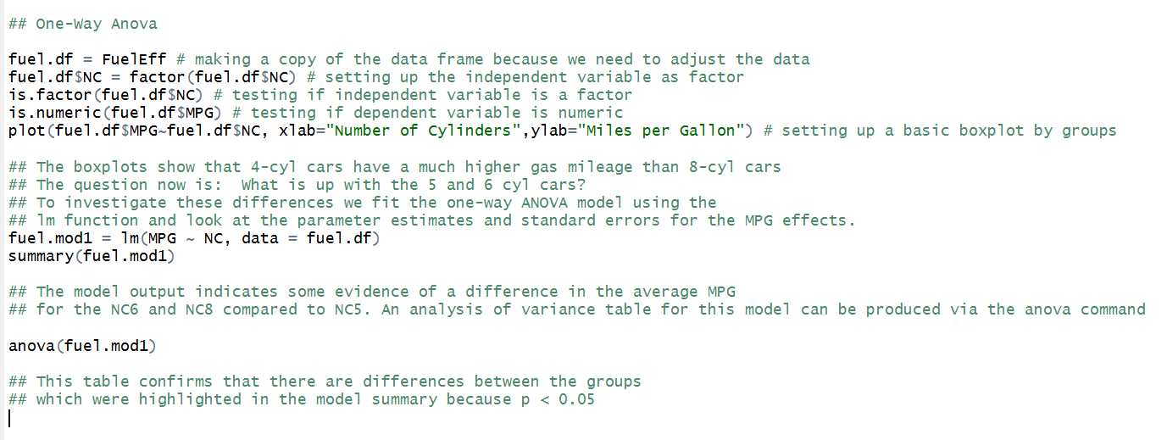
ANOVA in R

Slide 25
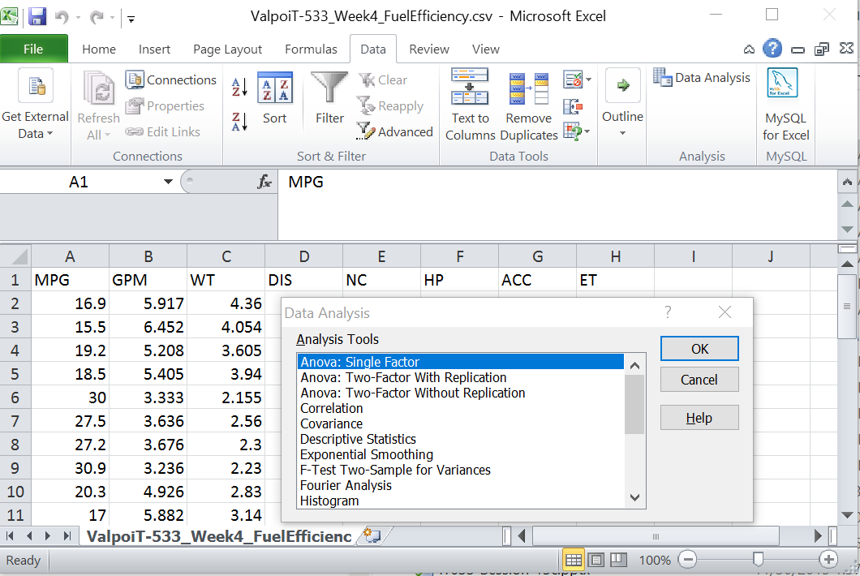
ANOVA in MS Excel

Slide 26
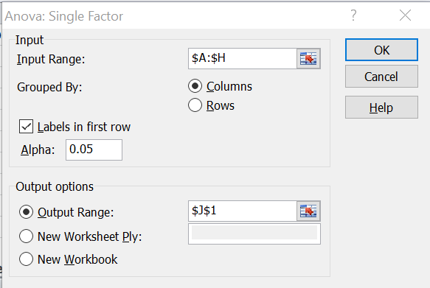
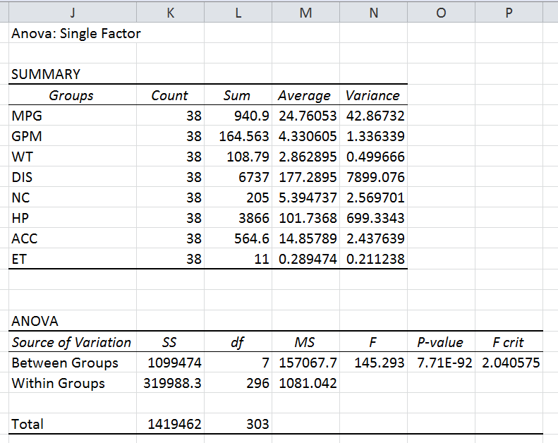
ANOVA in MS Excel
Value to which you are comparing p
Conclusion: if p > Alpha (0.05) (or if F > F crit), we reject the null hypothesis. The means of the 8 populations are not all equal. At least one of the means is different. However, the ANOVA does not tell you where the difference lies. You need a t-Test to test each pair of means.

Slide 27
Putting it all together: Recommender systems

Slide 28
Recommender Systems
How a recommendation system works.
How social filtering works
How to find similar items
Manhattan distance
Euclidean distance
Minkowski distance
Pearson Correlation Coefficient
Cosine similarity
Implementing k-nearest neighbors in Python
The Book Crossing dataset

Slide 29
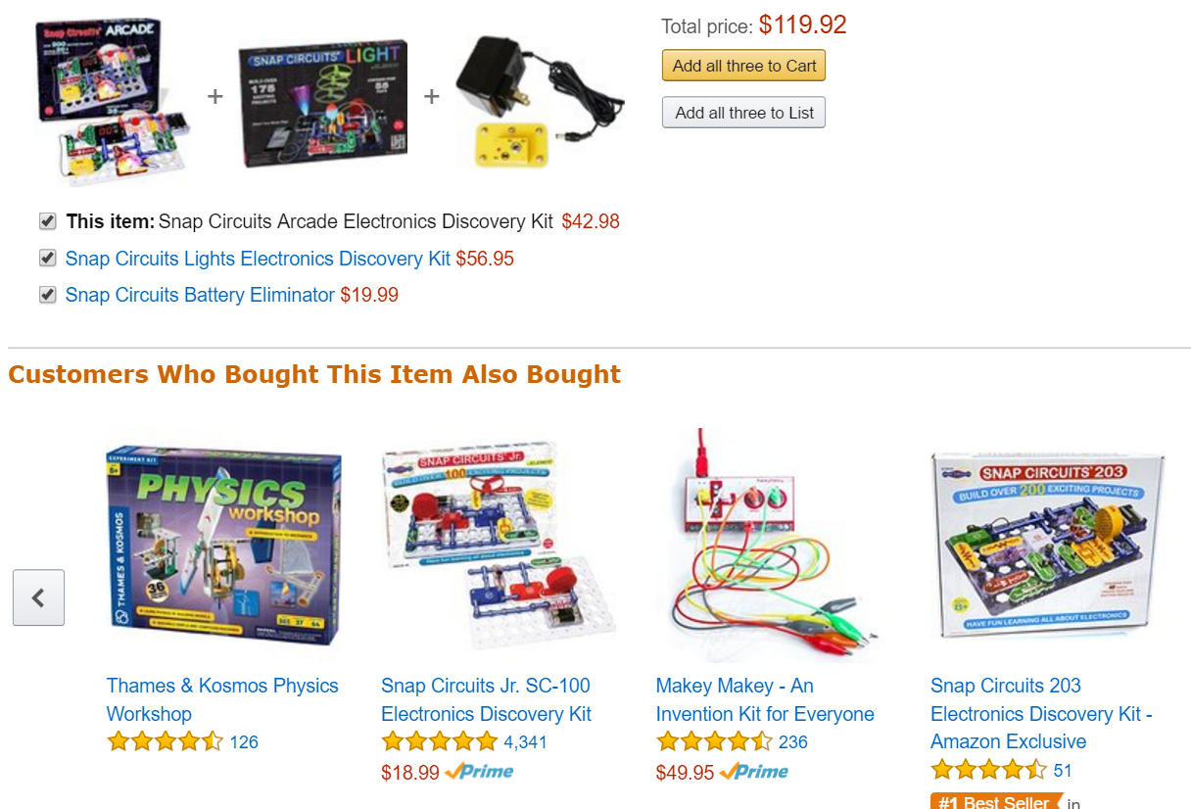

How a Recommender System Works
Customers who are like me!

Slide 30

Or like this
It’s all about finding out how data is related.
http://brandcheerleader.com/2015/02/13/bright-cellars-3/?n_id=ff&a_id=fcs

Slide 31
How is data related?
Distance measurements:
Euclidian distance
Manhattan distance
Measurements of Independence:
Chi Square
Covariance
Correlation
Measurements of Comparison:
Regression (single and multiple)
ANOVA
Relationships
Cosine Similarity

Slide 32
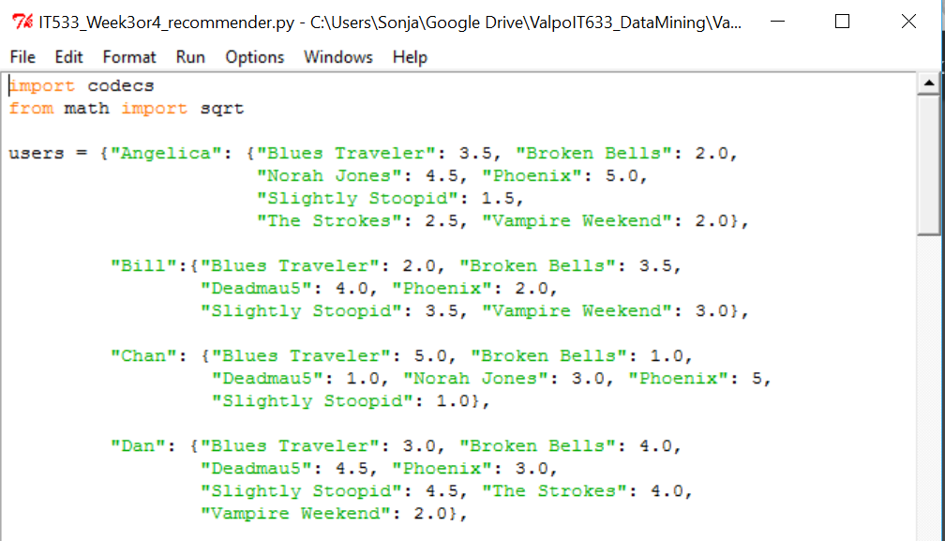
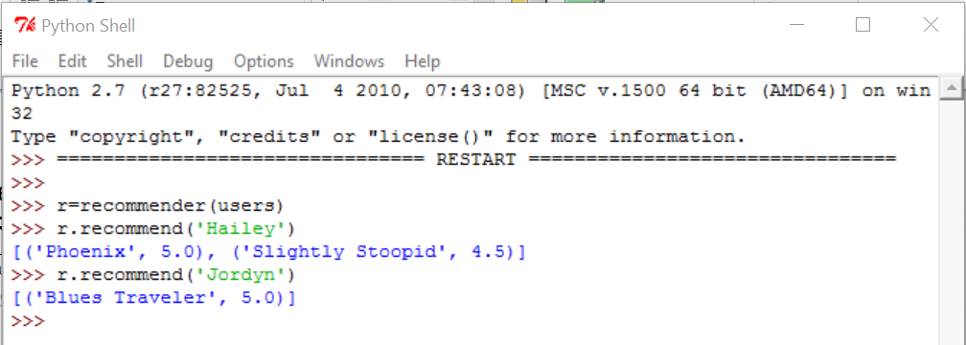
Recommender System
See Zacharias, http://guidetodatamining.com, Ch. 2
Open recommender.py in Python
Select Run > Run Module
Observe the output in the output window
For future reference, you might want to download Canopy, one of the better Python IDEs: https://store.enthought.com/downloads/#default

Slide 33
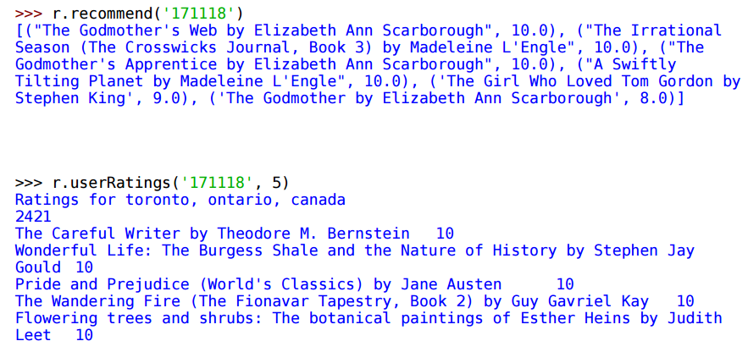
Exploring Python and Recommender Systems
Starting on Zacharias, Chapter 2, p. 54, let’s step through the example together. The data comes from the Book Crossing website. It exists in three files at http://guidetodatamining.com/assets/data/BX-Dump.zip
BX-Users
BX-Books
BX-Book-Ratings
Review the recommender code again and load the book data into Python:
>>> r.loadBookDB(‘<your path>/BX-Dump/')
Then follow the exercise:

Slide 34
How Would You …
The book website has a file containing movie ratings for 25 movies at http://guidetodatamining.com/assets/data/Movie_Ratings.csv .
How would you:
Create a function that loads the data into your classifier.
The recommend method described should recommend movies for a specific person.

Slide 35
Week 4 quiz

Slide 36
Week 4 Quiz
You are the data analyst on the regional management team for the orange juice company shown in your question. Your juice is being sold in 83 stores in the greater Chicago area and is competing with two other brands. Store numbers are organized as follows:
2-53: West
54-86: North
88-111: East
112-137: South
Your sales manager has reviewed your analysis from the previous exercise, but isn't convinced yet that she can see how the sales per region are really different from one another; it is your job this week to investigate whether they are. You will be using the same dataset with weekly sales and demographic information.

Slide 37
Week 4 Quiz
You work for the NNNN brand. Your state sales manager is looking for more answers.
Here are the questions she needs you to answer:
Given all the regional sales for your brand, are the sales per region really that different from each other? (3 points)
Given all brand sales in all regions, does region really matter? Make sure to provide a clear explanation that your state sales manager will understand with recommendations as to how to use the information in order to increase sales. (3 points)
In what region do you see the largest potential for sales increase? Explain the thinking steps and show the R code you used to determine this. Make sure to provide an answer to your question and recommendations for sales strategies that your state sales manager will understand. (4 points)
Please include screenshots of your R code and its outcomes. Remember that the results of your work and the sales strategy recommendations must be interpreted in language that the state sales manager can understand.

Slide 38
Week 4 Quiz Dataset
The attributes in your dataset are:
store | Store number
brand | OJ Brand
week | Week in which advertisements are run
logmove | Log units sold, normalized
feat | Feature advertisement
price | Retail price
AGE60 | Percentage of the population that is aged 60 or older
EDUC | Percentage of the population that has a college degree
ETHNIC | Percentage of the population that is African-American or Hispanic
INCOME | Median income
HHLARGE | Percentage of households with 5 or more persons
WORKWOM | Percentage of women with full-time jobs
HVAL150 | Percentage of households worth more than $150,000
SSTRDIST | Distance to the nearest warehouse store (e.g. Walmart)
SSTRVOL | Ratio of sales of this store to the nearest warehouse store (e.g. Walmart)
CPDIST5 | Average distance in miles to the nearest 5 supermarkets
CPWVOL5 | Ratio of sales of this store to the average of the nearest five stores

Slide 39
Final project_n

Slide 40
Final Project 4
Now that you are familiar with correlation, regression, and ANOVA analysis, use R, Python, or Excel to determine which two or three attributes in your dataset are closely correlated. Then answer the following questions on 1 single-spaced page:
How did you decide which two or three attributes to pick for your analysis?
What correlation do the results of your analysis reveal?
Were there any surprises? Did you have to go back and pick different attributes and re-run your correlation exercise?
Can you predict future values of one attribute from a regression on one or two others?
Include screenshots of your R or MS Excel analysis (including how you set up your regression) and of your results and include your R code and your results.

Slide 41
For Next Week
# | Topic | Reading | Due 11:59 pm CST
5 | Patterns, Associations, Correlations: Frequent Itemsets, Apriori, Support and Confidence Measures, Recommender Systems | Han/ Kamber 6 Witten/Eibe 3, 4.1, 17.2 Zhao 9 Ledolter 16 (Market Basket Analysis) YouTube videos as posted | MW Quiz 5: Recommender systems S: FINAL_PROJECT_5: Using R or Python, preprocess your dataset to run with Apriori. Show and describe the output. What do the results tell you about the attributes in your dataset?

